Slide 1


Fahim Tajwar Saikat
Reg. No.: 2017831020
Dept. of Software Engineering
IICT, SUST
Internship at Inverse.AI

Slide 2
About
Founded in 2018
20+ employee
Currently operate from Sylhet
Works on their own product
Inverse.AI

Slide 3
Internship Activities
Learning Phase
Practice Phase
Real world task phase
As a ML Engineer

Slide 4
Learning Phase
Reading Events
Discussion and Q&A session
Documentation writing

Slide 5
Reading Events
Core topics on ML. e.g. classification, linear regression, logistic regression, gradient descent, etc.
Deep Neural Network workflow
Some types of neural network e.g. : cnn, rnn, lstm, etc.
Various neural network model e.g.: ResNet, Deeplab, etc.
Core topics on digital signal processing
And a countless number of papers.
of learning phase

Slide 6
Practice Phase
Taking part in the exam on the topic I’ve learned in Coursera.
Solve some problems in kaggle to judge my learning.

Slide 7
Real world task phase
Background Remover
Noise Reducer

Slide 8
Background Remover
Separating background from the object of interest is a common problem in image processing
There are many semi-automated background remover algorithms available there.
I’ve implemented a manual background remover algorithm which is based on a 20-year-old paper. (NB:can’t reveal the name of the algorithm, as it says in NDA)
Applied some heuristics ideas along with data structure(like KD-Tree) to make it 1000x faster for an 8k image.
Made a hybrid mode, added the semi automated algorithm with the previously used DL model, which performs 2% better than the previous DL model in our dataset in term of MIOU score.

Slide 9
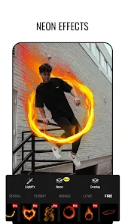
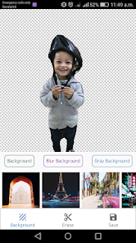
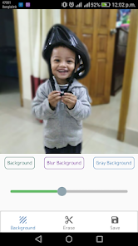
Impact of Background Remover
This feature is used in almost every photo editing software in Inverse.AI, e.g.: effect on humans(neon effects), removing background, blur background, etc.

Slide 10
Noise Remover
Noise Removing is a classic problem in digital signal processing, which gets a new pace with DL.
In this project I was given a DL model and my task was to reimplement the code using Tensorflow and keras framework.
Trained the model with 200 gb audio data(DNS dataset + our custom dataset)
Trained the model in using 8x Nvidia A100 GPU on datacrunch.io
Used distributed training to make the training faster.

Slide 11


Impact of Noise Reducer
Audio noise Reducer is one of the most important apps of Inverse.AI
The MOS accuracy is far far better than the previous noise reducer method.

Slide 12
Conclusion
Bridges the gap between industry and academia
Help to gain professional attitude, growth, maturity and judgement.
In word, it is experience of life time.

Slide 13
Thank
You

